Slide 1




CONTRACT COMPASS
2025 City Hackathon
Challenge 3: Tools for Local Business Partners

Slide 2




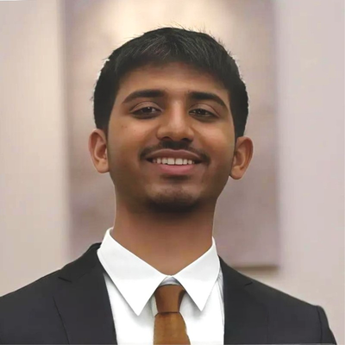
TEAM
Ibrahim Malik
Fayadh Chowdhury

Slide 3



PROBLEM
1
2
3
Matching Community Codes
Creating Business Profiles
Finding Contracts

Slide 4
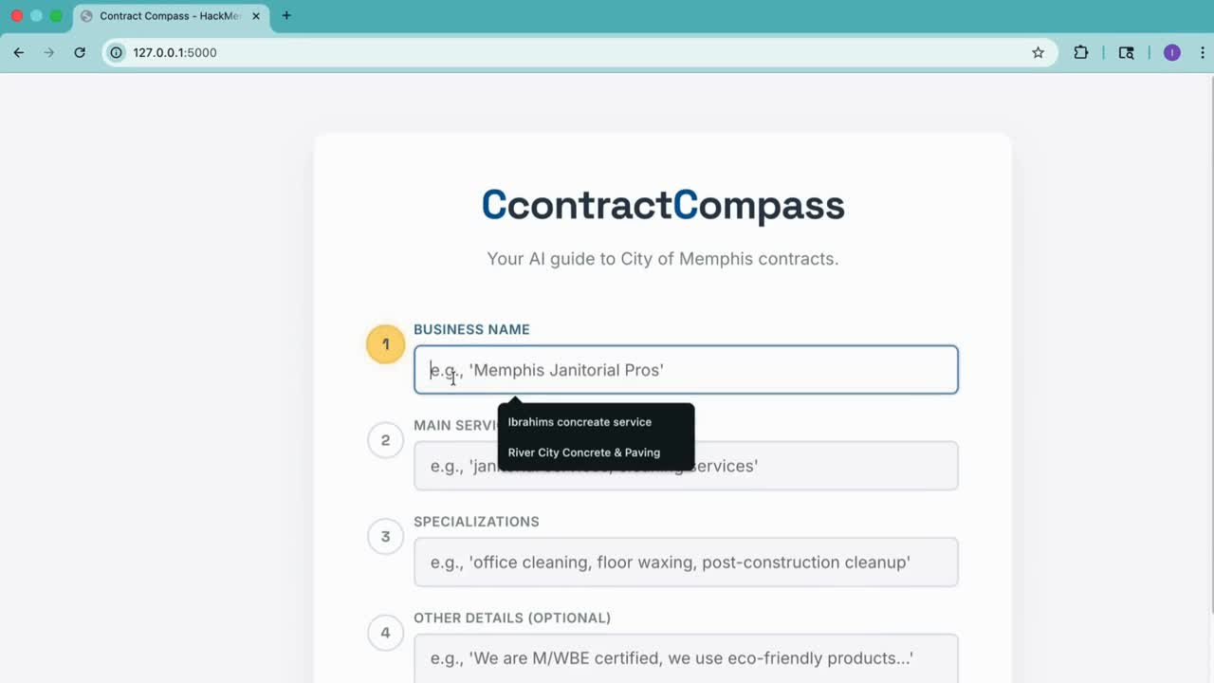

Slide 5



1
WHATS
NEW?
2
We created a platform where vendors can now generate business profiles, find their appropriate community codes, and match with open contracts.
We have re-organized the Community Codes to be available in CSV format which is much easier to build applications with than a PDF.

Slide 6


TECH AND WHAT’S NEXT
Today
Next
Frontend: HTML5, modern CSS, vanilla JavaScript
Backend: Python (Flask)
AI/LLM: Gemini Flash 2.0
Data: Selenium headless browser scraping for live procurement data
Fine tune the profile builder
Add more tools to improve holistic application process
Make the vendor profiles saveable by staff for future contracts

Slide 7



THANK YOU
CONTRACT COMPASS

